Slide 1
Human Computer Interaction
Usability Engineering

Slide 2
Today’s Lecture
Goals of HCI
Usability
User Experience
Usability Engineering
Interdisciplinary Nature of HCI

Slide 3
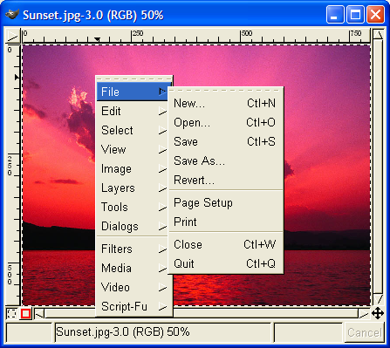
Usability?
Gimp windows had no menus – instead, right-click to get a popup menu and navigate further. Is this a fast way to select commands?
Notes:
Gimp is an open-source image editing program, comparable to Adobe Photoshop. Gimp’s designers made a strange choice for its menus. Gimp windows have no menu bar. Instead, all Gimp menus are accessed from a context menu, which pops up on right-click.
This is certainly inconsistent with other applications, and new users are likely to stumble trying to find, for example, the File menu, which never appears on a context menu in other applications. (I certainly stumbled as a new user of Gimp.) But Gimp’s designers were probably thinking about expert users when they made this decision. A context menu should be faster to invoke, since you don’t have to move the mouse up to the menu bar. A context menu can be popped up anywhere. So it should be faster. Right? Wrong….

Slide 4
Usability
User Experience
Interface
Interaction
Computer
Human

Slide 5
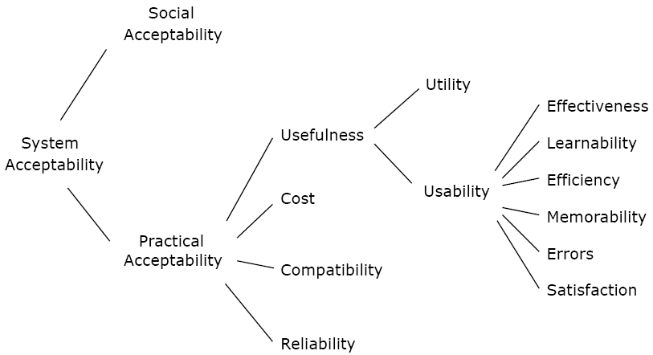
Attributes of System Acceptability
Notes:
Utility is the question of whether the functionality of the System in principle can do what is needed, and usability is the question of how well users can use that functionality.
https://books.google.com.pk/books?id=95As2OF67f0C&pg=PA25&lpg=PA25&dq=a+model+of+the+attributes+of+system+acceptability+by+nielsen&source=bl&ots=3aAFCofs0r&sig=Lu7rHDREEZ_Ig3pxUlwOWQ50dK0&hl=en&sa=X&ei=t2onVdvVCcneaLDfgiA&redir_esc=y#v=onepage&q=a%20model%20of%20the%20attributes%20of%20system%20acceptability%20by%20nielsen&f=false

Slide 6
Usability
The ISO defines usability as
“the extent to which a product can be used by specified users to achieve specified goals with effectiveness, efficiency and satisfaction in a specified context of use.”
ISO [1998]. Ergonomic Requirements for Office Work with Visual Display Terminals (VDTs) – Part 11: Guidance on Usability
(ISO 9241-11:1998)

Slide 7
Measureable Usability Attributes [Nielsen, Jakob [1993]. Usability Engineering. Morgan Kaufmann]
Learnability: ease of learning for novice users.
Efficiency: steady-state performance of expert users.
Errors: error rate for minor and catastrophic errors.
Memorability: ease of using system intermittently for casual users.
Effectiveness: completeness with which users achieve their goal.
Satisfaction: how satisfying a system is to use, from user’s point of view.
Notes:
Learnability: The system should be easy to learn so that user can rapidly start getting some work done with the system.
Efficiency: Once users have learned the design, how quickly can they perform tasks?
Memorability: When users return to the design after a period of not using it, how easily can they reestablish proficiency?
Errors: How many errors do users make, how severe are these errors, and how easily can they recover from the errors?
Satisfaction: How pleasant is it to use the design?

Slide 8
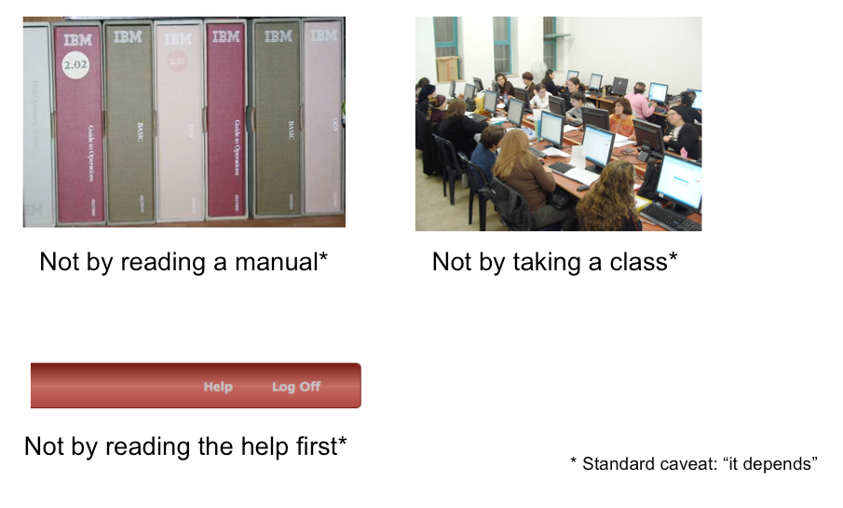
Learnability How we learn a New User interface?
Notes:
When computers first appeared in the world, there were some assumptions about how people would learn how to use the software. Programmers assumed that users would read the manual first – obviously not true. Companies assumed that their employees would take a class first – not always true. Even now that we have online help built into virtually every desktop application, and web page help often just a search engine query away, users don’t go to the help first or read overviews.
All these statements have to be caveated, because in some circumstances – some applications, some tasks, some users – these might very well be the way the user learns. Very complex, professional-level tools might well be encountered in a formal training situation – that’s how pilots learn how to use in-cockpit software, for example. And some users (very few of them) *do* read manuals.
Nearly all the general statements we make in this class should be interpreted as “It Depends.” There will be contexts and situations in which they’re not true, and that’s one of the complexities of UI design.

Slide 9
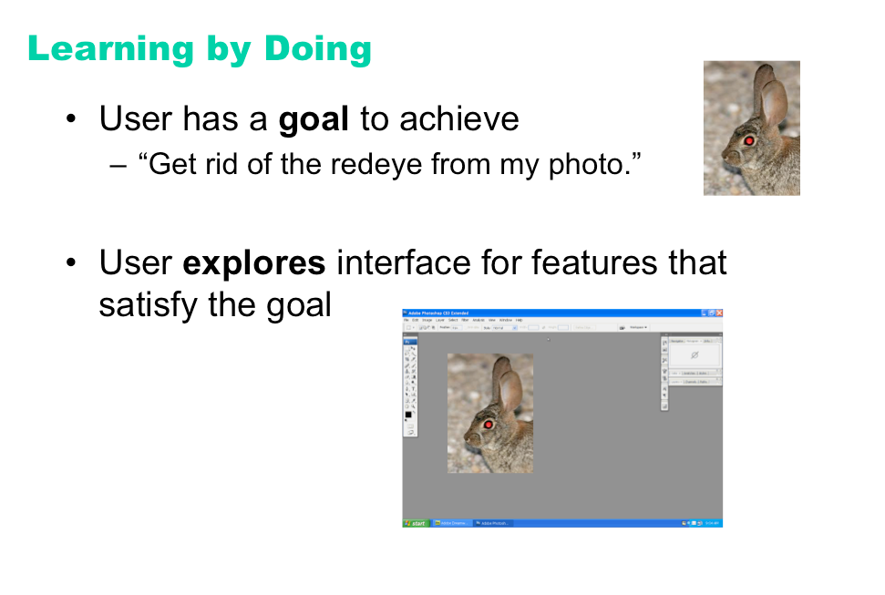
Learnability
Notes:
So users don’t try to learn first – instead, they typically try to do what they want to do, and explore the interface to see if they can figure out how to do it. This practice is usually called learning by doing, and it means that the user is starting out with a goal already in mind; they are more interested in achieving that goal than in learning the user interface (so any learning that happens will be secondary); and the burden is on the user interface to clearly communicate how to use it and help the user achieve their first goal at the same time.

Slide 10
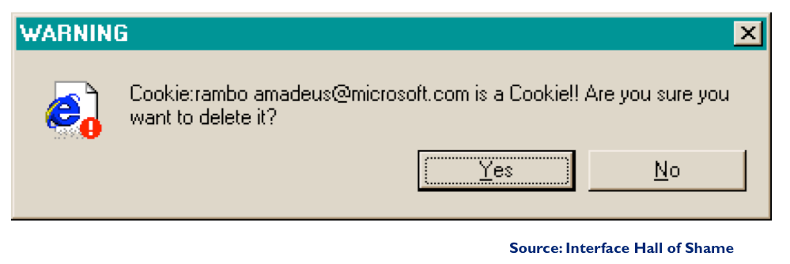
Efficiency

Slide 11
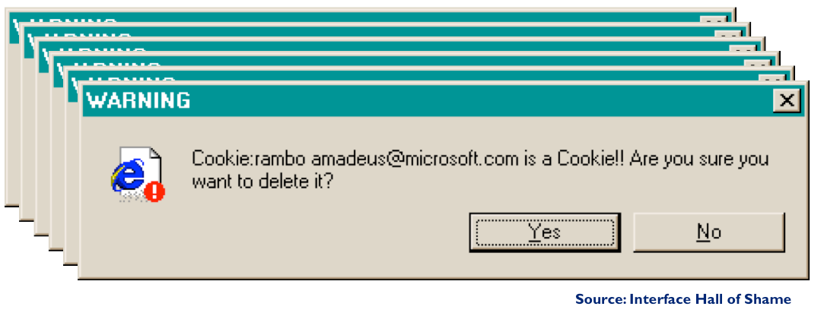
Efficiency

Slide 12
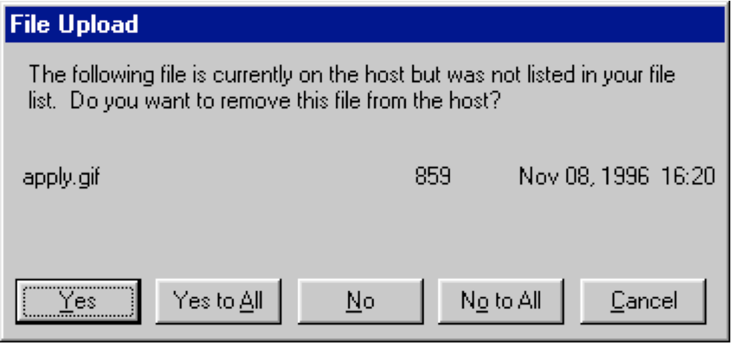
Efficiency

Slide 13
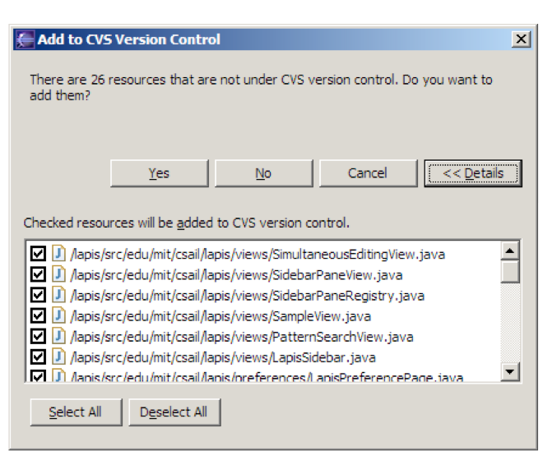
Efficiency

Slide 14
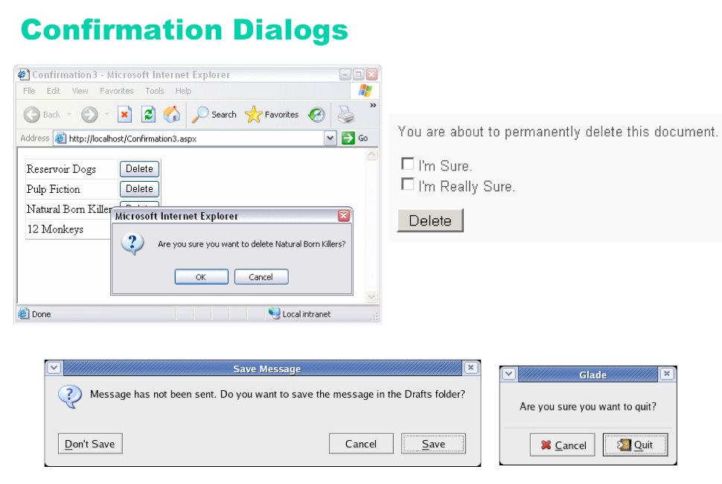
Error Prevention
Notes:
An unfortunately common strategy for error prevention is the confirmation dialog, or “Are you sure?” dialog.
It’s not a good approach, and should be used only sparingly, for several reasons:
• Confirmation dialogs can substantially reduce the efficiency of the interface. In the example above, a
confirmation dialog pops up whenever the user deletes something, forcing the user to make two button presses
for every delete, instead of just one. Frequent commands should avoid confirmations.
• If a confirmation dialog is frequently seen – for example, every time the Delete button is pressed – then the
expert users will learn to expect it, and will start to include it in their habitual procedure. In other words, to
delete something, the user will learn to push Delete and then OK, without reading or even thinking about the
confirmation dialog! The dialog has then completely lost its effectiveness, serving only to slow down the
interface without actually preventing any errors.
In general, reversibility (i.e. undo) is a far better solution than confirmation. Even a web interface can provide
at least single-level undo (undoing the last operation). Operations that are very hard to reverse may deserve
confirmation, however. For example, quitting an application with unsaved work is hard to undo – but a welldesigned
application could make even this undoable, using automatic save or keeping unsaved drafts in a
special directory.

Slide 15
Memorability
Memorability is a measure of how easy a software is to remember after a substantial time-lapse between visits.
Notes:
Once a user has taken the time to learn how to navigate a website and find what they are looking for; they need to be able to remember how to do it when they come back. A website needs to have high memorability. Memorability is a measure of how easy a website is to remember after a substantial time-lapse between visits.
If a website has good learnability and memorability, visitors are sure to keep coming back for more. When we are designing a website we try to maximize the memorability by creating logical steps and consistent design throughout the site.

Slide 16
Effectiveness
Effectiveness is the completeness and accuracy with which users achieve specified goals

Slide 17
Satisfaction
Satisfaction refers to how pleasant it is to use the system

Slide 18
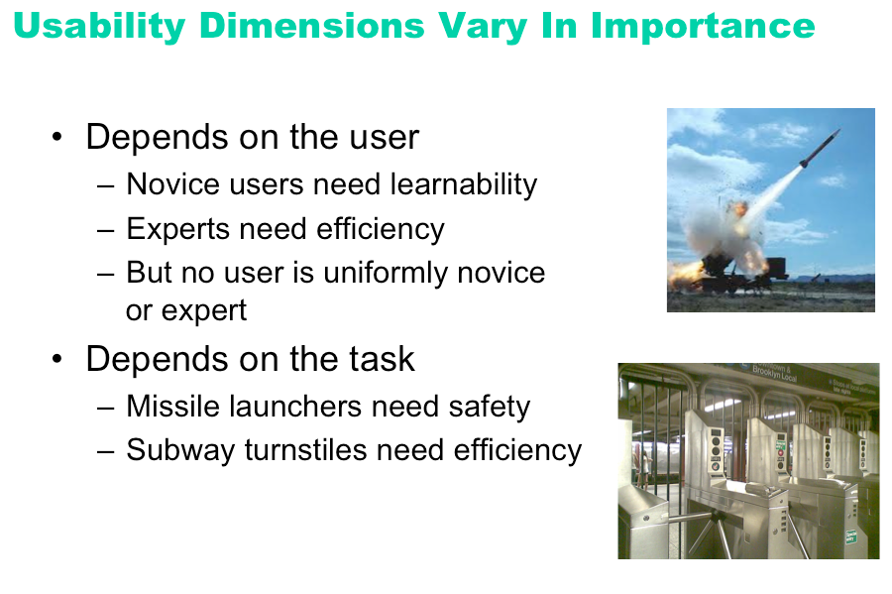

Slide 19
Context is Important
The usability dimensions are not uniformly important for all classes of users, or for all applications.
A web site used only once by millions of people has such a strong need for ease of learning, in fact zero learning
A stock trading program used on a daily basis by expert traders, for whom lost seconds translate to lost dollars, must put efficiency above all else.
A military application may needs the stability and security the most
Researching the user and the context is thus very important

Slide 20
Measuring Usability Attributes
Learnability:
pick novice users of system, measure time to perform certain tasks. Distinguish between no/some general computer experience.
Efficiency:
decide definition of expertise, get sample expert users (difficult), measure time to perform typical tasks.
Errors:
count minor and catastrophic errors made by users while performing some specified task. For example, number of deviations from optimal click path.
Notes:
Effectiveness
The extent to which users can achieve their task goals.
Effectiveness measures the degree of accuracy and/or completion
e.g.,if desired task goal is to locate information on a web site then:
Effectiveness= success of user in locating the correct data
If the outcome is ALL or NOTHING then effectiveness is an absolute value
-User either locates info or does not...
If outcome can be graded, (user can be partially right) then effectiveness should be measured as a scale
-As a %, or a score from 1 (poor) to 5 (complete)
Scale should be determined by evaluator in conjunction with developers and users
Efficiency
Measures resources used to perform task
i.e., time, effort, cost,
In case of Web site use, efficiency might equal time taken to complete a task or the navigation path followed etc.
Time taken to complete task
Compared across tasks, across users or against a benchmark score
Number of steps taken
Number of deviations from ideal path
Such variables are frequently highly positively correlated - but they needn’t be.
Satisfaction:
Measures the affective reaction (likes, dislikes, attitudinal response) of users to the application
Assumed to be influenced but not the same as effectiveness or efficiency e.g.,
2 applications with equal effectiveness, and efficiency, may not be equally satisfying to use
or What users like might not be what they need!

Slide 21
Measuring Usability Attributes
Memorability:
get sample casual users (away from system for certain time),
Effectiveness:
decide on definition of success. For example, number of substitution words spotted in a text, or binary measure of success (order completed or not).
Satisfaction:
ask users’ subjective opinion (questionnaire), after trying system for real task.

Slide 22
User Experience – A Definition
The user experience is the holistic combination of everything that the user
Sees
Touches
Feels
Interacts with

Slide 23
User Experience Goals
Satisfying
Enjoyable
Fun
Entertaining
Helpful
Motivating
Aesthetically Pleasing
Supportive to Creativity
Rewarding
Emotionally Fullfilling

Slide 24
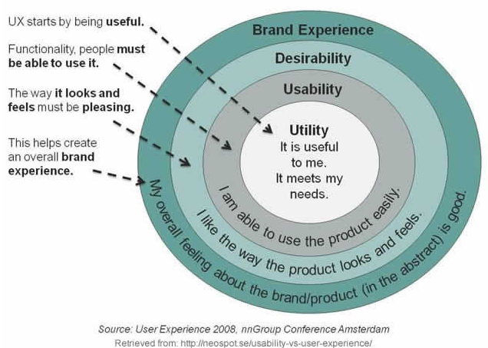

Slide 25
What do you think are the key usability goals and user experience goals for following examples?
A mobile device that allows young children to communicate with each other and play collaborative games
A video and computer conferencing system that allows students to learn at home
An online community that provides support for people who have recently been bereaved
Notes:
Easy to use, effective efficient, easy to learn , fun and entertaining
Easy to learn, effective , efficient , motivating and rewarding
Easy to learn easy to use, motivating, emotionally satisfactory

Slide 26
Usability Engineering
An iterative process to improve usability of a system.

Slide 27
Interdisciplinary Nature of HCI
HCI is understanding the Complex Relationship between Human and Computers
Two Distinct “Species”
Successful Integration is dependent upon the a better understanding of both Species
Hence HCI borrows and establishes its roots in Disciplines concerned with both

Slide 28
Interdisciplinary Nature of HCI – Human Side
Cognitive Psychology
Understanding human behavior and mental processes
Social Organizational Psychology
Studying nature and causes of human behavior in social context
Ergonomics and human Factors
It is the study of designing equipment and devices that fit the human body and its cognitive abilities.
Linguistics
Linguistics is the scientific study of language
Anthropology and Sociology
Sociology is the academic study of social behavior, its origins, development, organization, and institutions.

Slide 29
Interdisciplinary Nature of HCI – Computer Side
Computer Science
Provides knowledge about capability of technology
Developing techniques to support software design, development and maintenance
Artificial Intelligence
Intelligent Computing concerned with simulating human behavior
HCI – development of expert and tutoring systems
Engineering and Design
Engineering takes finding of sciences and utilizes them in the production of artifacts
Design contributes creative skills and knowledge to this process

Slide 30
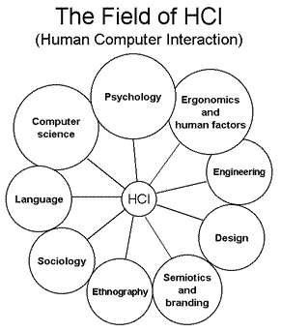
HCI: AN Interdisciplinary Area
Notes:
Case Study – Ticketing System
A small travel agency with a number of shops distributed throughout the country decides
that, in order to survive in the travel industry, it needs to install an efficient ticketing
system. Current practice involves sales staff in a lengthy procedure for issuing tickets to
customers. First they have to call an airline to check if there are any vacant seats for the
time when the customer wishes to fly. Then they have to check with the customer which
of the available seats is suitable before making a reservation with the airline. The ticket is
then written out by hand. In addition, the customer needs a receipt and an itinerary, which
are also written by hand. One of the biggest problems with this practice is getting a
telephone connection to the airline. This means that customers often have to wait while a
frustrated sales assistant keeps trying in vain. To overcome this problem it is common
practice to ask the customers to come back later in the hope that the sales staff will
manage to get through to the airline in the meantime. Another time-consuming job is
accounting for each ticket that has been issued, and the sales staff has to do this by hand
every two weeks.
Before deciding to get new system the branch manager does some background research
into how the agency really functions. She starts by visiting branches in a sister company
that is using a computerized ticketing system. After talking to the staff for just a short
time she discovers that there are problems. The sales staff complains that the computer is
always going wrong and that they don’t trust it. Furthermore, they can’t understand some
of the messages that it produces when they make errors. In fact, they wish they could go
back to the old un-computerized way of working. Sales figures since the new system was
installed are also disappointing and a large number of staff have left the office. Not
surprisingly, the manager is consultants examine the users’ needs and how they currently
go about their work in detail and also find out exactly what the goals of the company are.
They then recommend a system with the following characteristics:
• Immediate ticket booking via a computer connection (alleviating the problem of
engaged phone line),
• Automatic print-out of tickets, itineraries and receipts (eliminating the need to
write these by hand and thereby reducing the possibility of errors and illegibility
while speeding up the process),
• Direct connection between the booking system and accounting (speeding up the
process of accounting),
• Elimination of booking forms (reducing overheads as less paper and time are
used).
The consultants suggest making the interface to the system mimic the non-computerized
task, so menus and forms are used, which means that the sales assistant only has to select
options and fill in the resulting forms by typing at a keyboard.
The consultants are optimistic that customer satisfaction will improve because customer
will get their tickets on the spot. They point out to the manager, however, that in order to
get the most out of the new system the layout of the agency needs to be changed to make
it comfortable for the sales staff to operate the compute, while still providing scope for
direct contact with customers. Staff will also need training, and some careful changes to
existing jobs are needed too—job design. In particular, technology means that they will
need support during the period of change. Staff will also need to know how to cope when
an airline’s computer malfunctions. Changes in employment conditions must also be
examined. For instance, if staff is expected to carry out more transactions in less time, are
they going to be rewarded for this extra activity? Staff relations with other staff in the
company who will not be using the computerized system must also be taken into account.
For example, problems associated with technology power such as feelings f elitism
among staff that know how to use the new technology, will need to be resolved.

Slide 31
Reference Material
Interaction Design: Beyond Human - Computer Interaction (3rd ed.), by Yvonne Rogers, Helen Sharp, Jenny Preece. Wiley, 2011.
Human-Computer Interaction (3rd ed.), by Alan Dix - Janet Finlay - Gregory Abowd - Russell Beale PRENTICE HALL 2004
Usability Engineering edited by Jakob Nielsen

